Slide 1

Interacting with Large Distributed Datasets with Sketch
Mihai Budiu, Rebecca Isaacs, Derek Murray, Gordon Plotkin, Paul Barham, Samer Al-Kiswany, Yazan Boshmaf, Qingzhou Luo, Alexandr Andoni
Work done at Microsoft Research, Silicon Valley https://youtu.be/NkV5r7OzCoc

Slide 2



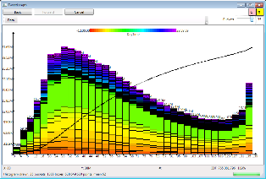
Motivation
Work on large-scale computation engines (> 10⁵ computers)
Analyze large logs and/or large datasets
Problem: browse 10⁹ data points using 10⁶ pixels

Slide 3

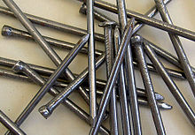
Aggregation
Solution: display aggregates
Sketch = a system which can ONLY compute aggregates
Try to express all data operations using aggregates
“If all you have is a hammer, everything looks like a nail”
Maslow’s law

Slide 4


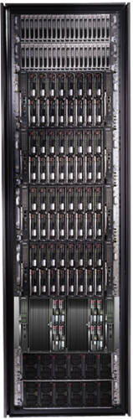
Bandwidth hierarchy

Slide 5
Distributed visualization applications
User
User
View
View
Sketch
Data model
Network
Sketch
Sketch
Data model
Data model
Single machine
Distributed system

Slide 6

Parallelizing with Sketch
Sketch library handles all distributed system aspects
Network communication
Parallelization across machines and cores
Fault tolerance
Straggler avoidance (slow workers)
Distributed garbage-collection
3 applications
Billion-row spreadsheet
Performance analyzer
Distributed log browser

Slide 7


Principles
Visualizations are bounded data displays
We cannot show all data
Do not compute views with resolution exceeding screen resolution
Tools must run at interactive speeds
All aggregations are done using streaming algorithms
Multi-pass, randomized streaming algorithms
Sublinear memory
Insensitive to input order
Naturally parallelizable
Data never moves
Low network bandwidth required

Slide 8

Linear transformations
Commutative monoids (M, +, 0)
Linear functions between monoids:
f: M → N, f(a + b) = f(a) + f(b)
Lots of interesting monoids
Sets and multisets with union (collections)
Dictionaries over monoids M[K] (finite maps)
“Map” and “reduce” are linear functions
Linear transformations are the essence of data parallelism
Many streaming algorithms are linear transformations

Slide 9


Sketch distributed service
Requests = programs
Replies = aggregates
Sketch
service
Sketch
service
Sketch
service
Sketch
service
data
data
data
data

Slide 10
DataSets = distributed objects + aggregation API
Client
Application
DataSet<T>
Network
Servers
T
T
T
T
T
T
T
T
T
T
T
10

Slide 11
Sketch Spreadsheet architecture
GUI
Spreadsheet display
DataSet<Table>
Distributed objects
Table operations
Spreadsheet logic
SQL Server
CSV Files
Column store
Cosmos
Storage layer

Slide 12
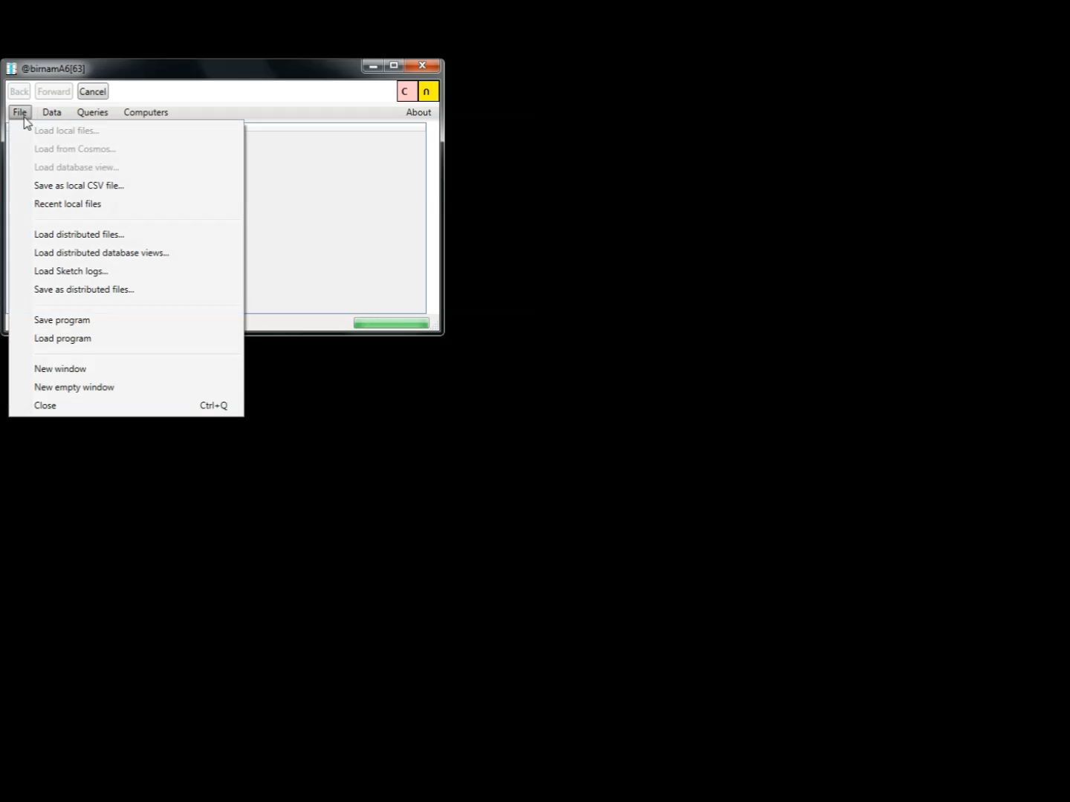

Slide 13
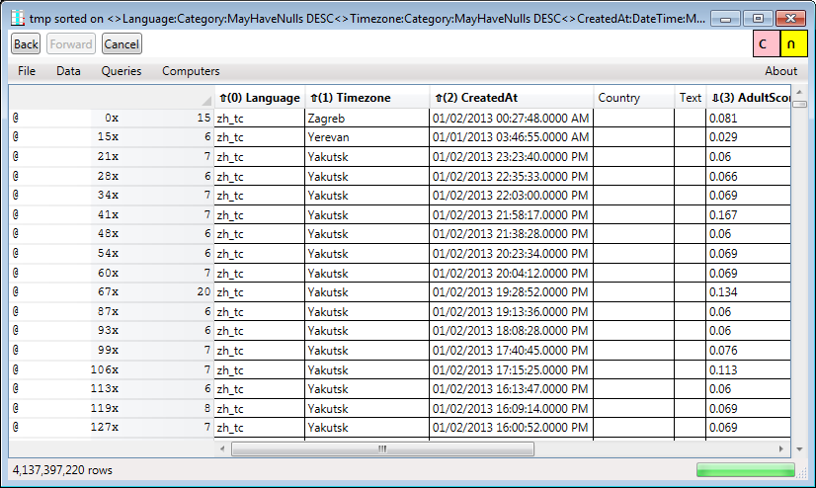
4 billion rows on 155 machines
Visible columns
Row header
Sorting order
Hidden columns
Row Scroll-bar
Position
Count
NextK sketch
Dataset size
Column scroll-bar

Slide 14
Spreadsheet operations
Cubing
Browsing/scrolling
Filtering
Using predicates
Heavy hitters
Sampling
Searching
Sorting
Computing new columns
Set operations (intersection, union, etc.)
Charting
Zooming
Pivoting

Slide 15

Histograms
CDF
2D
histogram
Histograms are monoids.
Sample data to make error bars smaller than 1 pixel =>
no visible information loss.

Slide 16
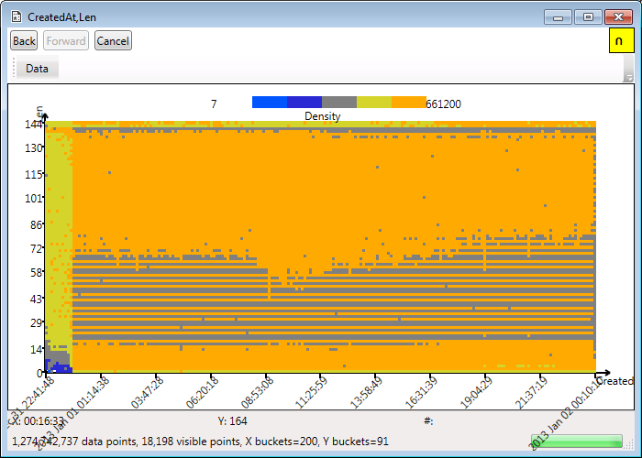
Heat Maps
Heatmaps are 2D histograms.

Slide 17
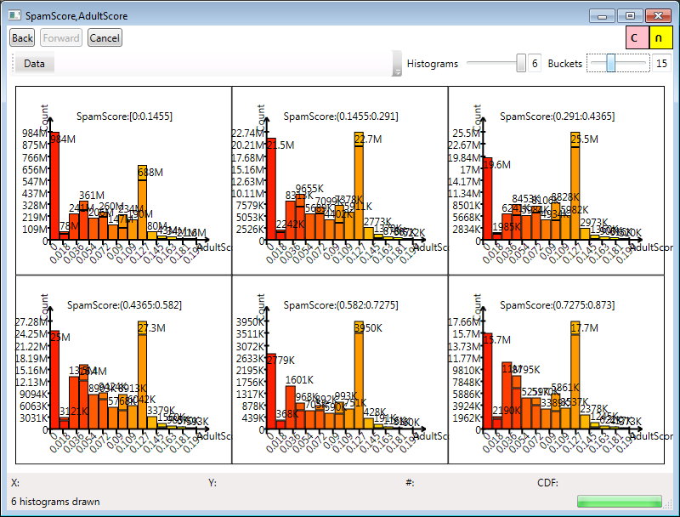
Multi-dimensional histograms

Slide 18
Scale-out experiment (constant data/machine)
Time (ms)
(a)
(b)
(c)
4.4B rows

Slide 19
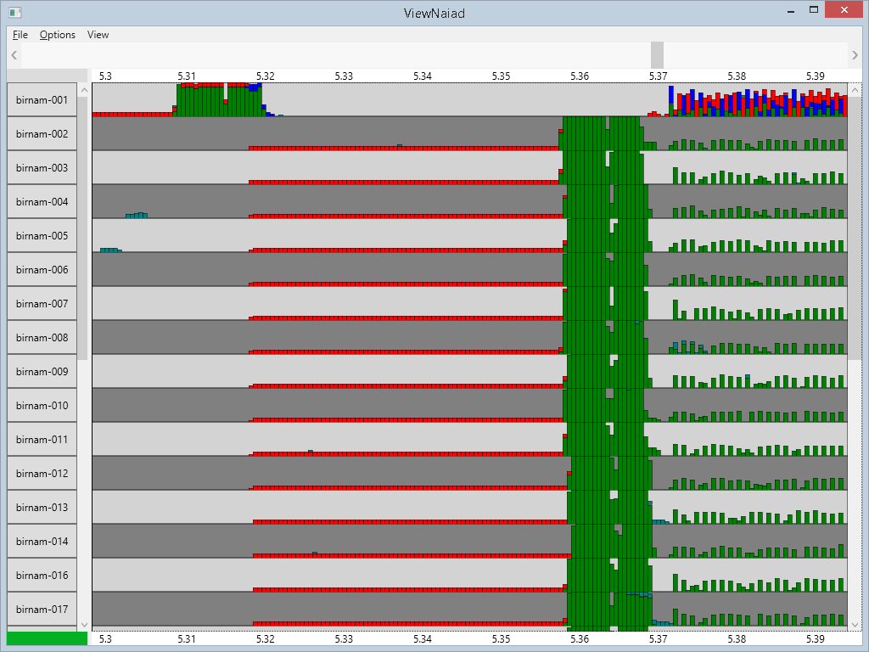
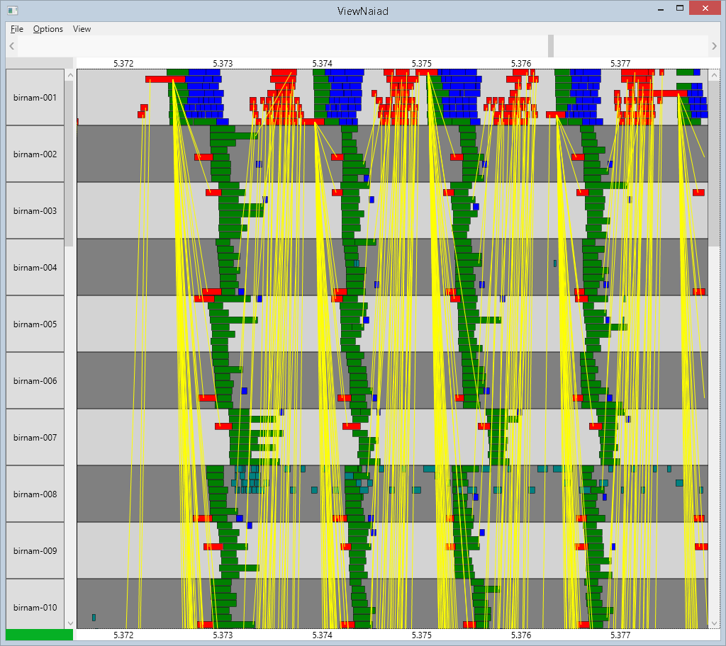
ClusterViewer: Performance Debugger
Time
Scroll-bars
Machine
CPU usage
Network messages
8 cores
Ported to run on top of Sketch in 1 person-week (single machine => distributed execution).

Slide 20

Conclusions
Large data visualization = aggregation
Aggregate data at source
Small results => interactive speeds
Formal tools:
Linear transformations
Streaming algorithms
Factored out distributed systems aspects in a library
Sketch is not a universal tool, but it is very useful

Slide 21
Backup slides

Slide 22
DataSet Core API
interface IDataSet<T> { IDataSet<S> Map<S>(IMap<T,S> f); IDataSet<Pair<T,S>> Zip(IDataSet<S> other); R Sketch(ISketch<T, R> sk); }
interface IMap<T,S> { S Map(T data); }
interface ISketch<T,R> { R Create(T data); R Combine(List<R> parts); }
Serializable closures.
(Other features not shown: asynchronous computation, remote execution, background operation cancellation, error and progress reporting, etc.)

Slide 23
Map(f)
Proxy
Proxy
Parallel
Parallel
Local
Local
Local
Local
T
T
S
S
f
f

Slide 24
Sketch(s)
interface ISketch<T,R> { R Create(T data); R Combine(List<R> parts); }
R
Proxy
s.Combine
R
Parallel
R
R
Local
Local
s.Create
T
T

Slide 25
Zip
Proxy
Proxy
Proxy
Parallel
Parallel
Parallel
Local
Local
Local
Local
Local
Local
T
T
S
S
T,S
T,S

Slide 26
DataSet Implementations
Address space
Application
GUI
Dataset
interface
Client
Cluster parallelism
Parallel
Proxy
Proxy
RMI layer
Network
Server 0
ref
Server 1
ref
ref
Server n
Parallel
Rack aggregation
Parallel
Proxy
Parallel
Core parallelism
Parallel
Local
Local
Local
Local
Local
Local
T
T
Rack 0
T
T
T
T
Rack r

Slide 27
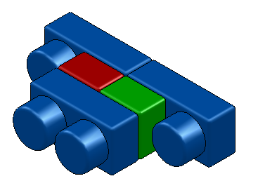
Dataset objects
Local dataset
Parallel => concurrency
Proxy => remote access
Replicated => fault-tolerance
Hedged => stragler avoidance
Lazy => batching
Identical interfaces on top and bottom
Can be stacked arbitrarily
Modular construction of distributed systems

Slide 28
NextK and Scrolling
NextK(startTuple, sortOrder, K)
Streaming algorithm
Commutative monoid over a set of K tuples
Monoid operation is “merge sort”
Scrolling
Compute startTuple based on scroll-bar position
Approximate quantile
Run NextK

